Slide 1
Perception of Pain

Slide 2
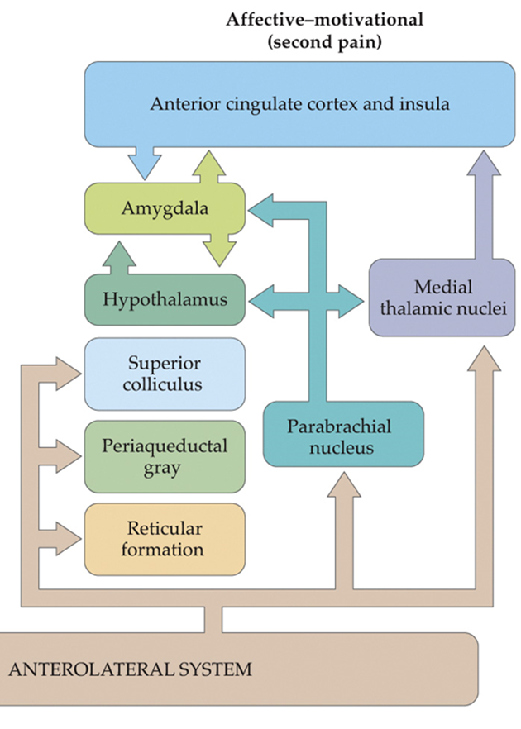
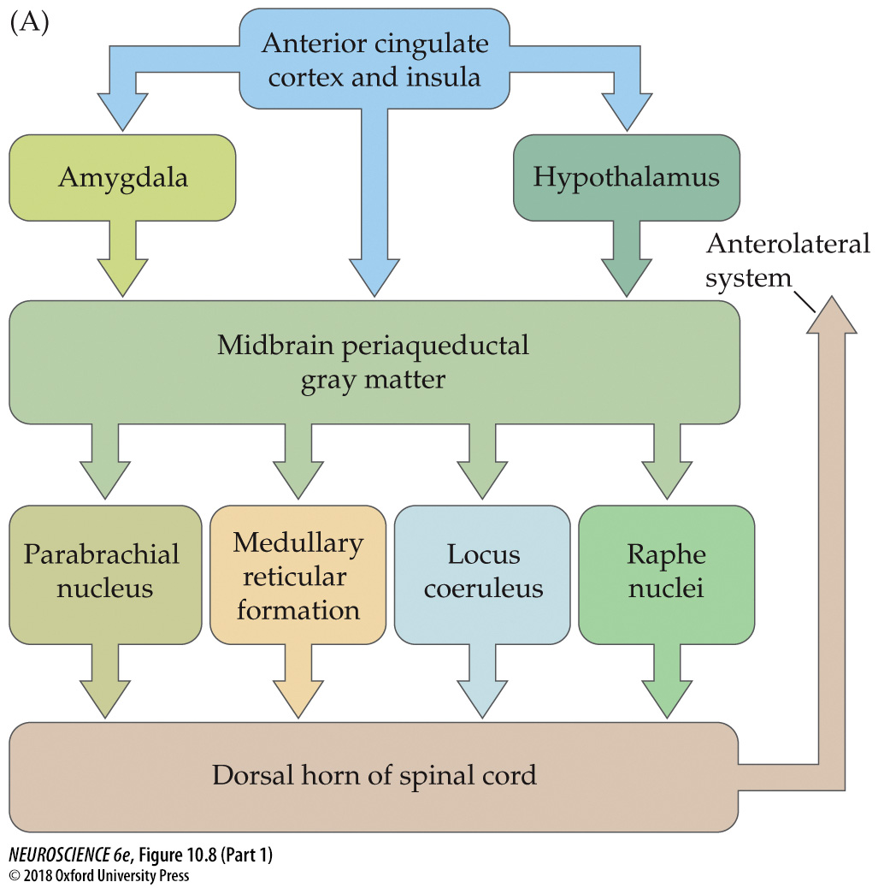
Descending Control of Pain
Brain to spinal cord pathway
  Stimulating any of these regions is associated with analgesia
  Can inhibit or facilitate signaling within spinal cord circuits
Sensitive to endogenous opioids
  Enkephalins
  Endorphins
  Dynorphins
Also involved in pain relief of endocannabinoids.

Slide 3
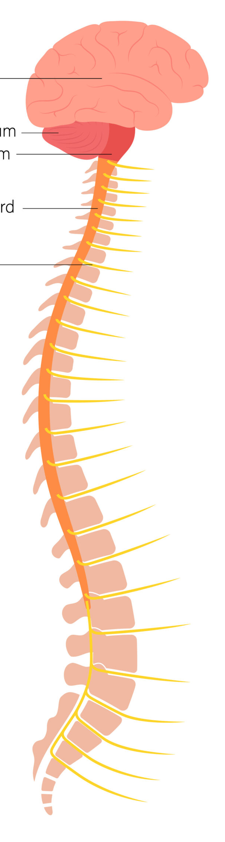
Descending control of pain
Pain perception depends on may factors:
  Activity of the autonomic nervous system
  Attention/Distraction:
    Generally, distraction reduces pain experience
    Contrasts with mindfulness meditation approach: non-judgmental awareness of the present-moment experience
  Expectation
    Placebo Effect: effect of an “inert” remedy; associated with the release of endogenous opioids
  Acupuncture and hypnosis

Slide 4
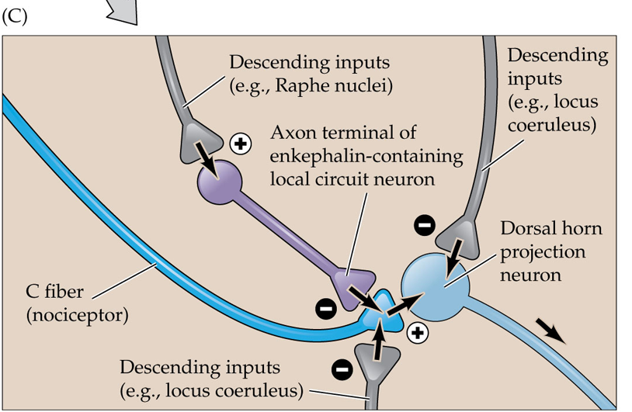
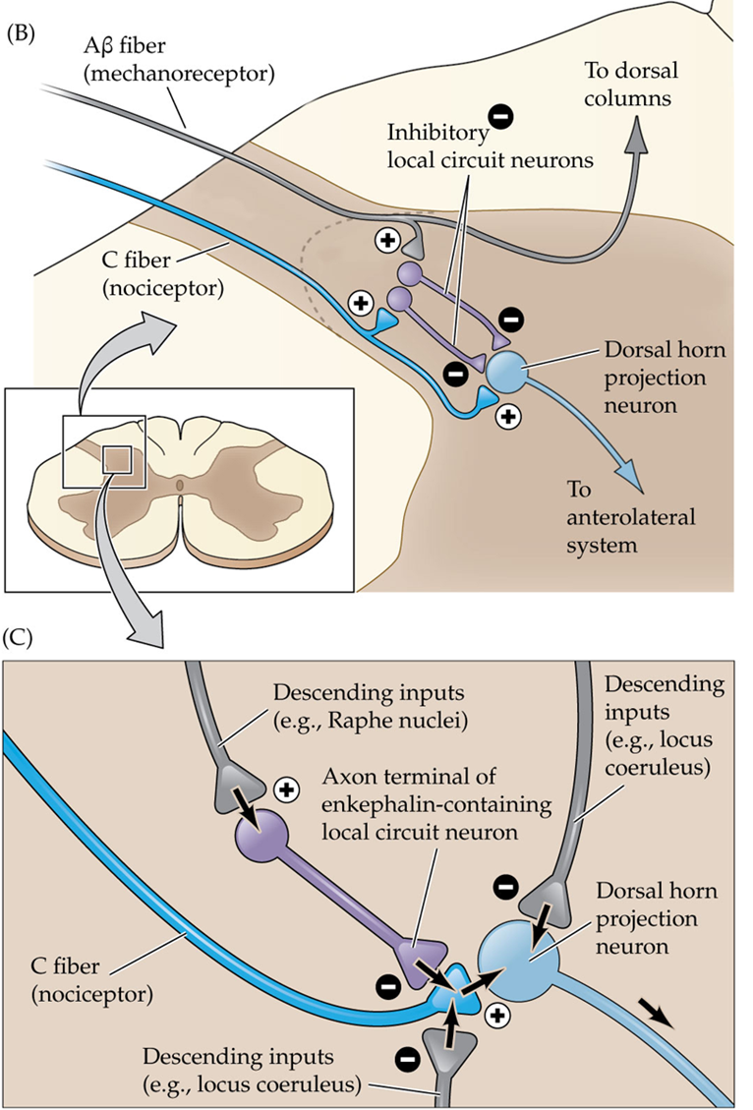
Local circuit modulation of pain:
Gate Control Theory
Mechanism 1: Descending inputs from the brainstem modulate the transmission of pain signals in the dorsal horn.
Mechanism 2: By activating low threshold mechanoreceptors, we can block transmission of pain signals to the brain.

Slide 5
There are two types of pain sensitization
Pain sensitization = becoming more sensitive to pain
Peripheral Sensitization | Central sensitization
Slightly noxious stimuli perceived as more painful. | Innocuous stimuli perceived as painful (aka allodynia)
Ex. Going into a hot tub with a bad sunburn. | Ex. Poking a sunburn
Involves mechanisms of primary hyperalgesia | Involves mechanisms of secondary hyperalgesia

Slide 6
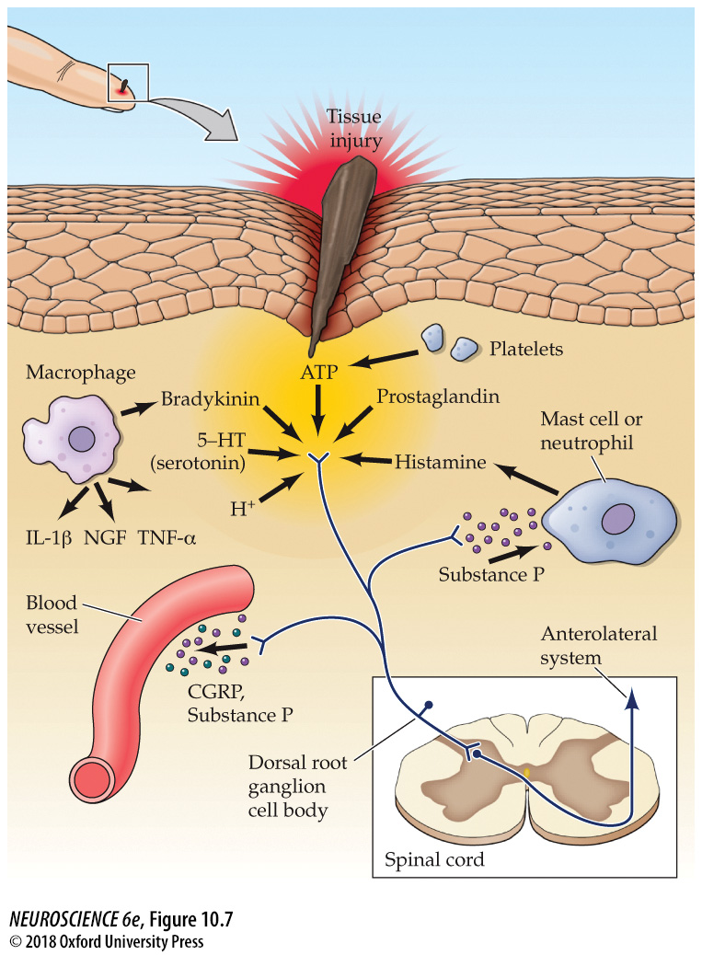
Peripheral sensitization
Tissue damage elicits an inflammatory response that enhances nociception.
  breaks cells & allows in potential infectious agents
  This activates nociceptors and immune cells
    Nociceptors release more inflammatory mediators (e.g., Substance P, CGRP, ATP)
    Non-neural cells release protons, histamine, prostaglandins, bradykinin, 5-HT …) → inflammation
  Stimulates production of chemicals that act on nociceptors to increase firing rates.
  These effects aim to promote healing and guard against infection.

Slide 7
“Inflammatory soup ingredients”
Substance P: produces vasodilation & edema around the initial damage.
Arachidonic acid (AA)/Prostaglandin E2 (PGE2): AA is metabolized into PGE2. PGE2 activates a Gs receptor (aka, PKA cascade), which blocks K+ efflux and enhances depolarization (more APs) & Gq (aka, PLC cascade)
Histamine: increases the permeability of blood vessels. This allows immune cells to reach an infected area.
ATP: acts on P2X receptors on nociceptors.
Bradykinin: promotes inflammation and vasodilation, sensitizes TRPV1 receptor via PLC cascade
Serotonin: enhances pain via TRPV1 in the spinal cord, but also use of SSRIs to treat pain
Extracellular Protons: tissue acidification
Inflammatory cytokines (e.g., IL-1β, TNF) act on nociceptor receptors to increase firing

Slide 8
Central Sensitization
Increase in excitability of neurons in the dorsal horn as a result of a
high level of activity.
typically occurs immediately after the noxious event and can outlast
the pain of the original stimulus by several hours.
Experimentally induced example → wind-up:
  exposure to repeated, low-frequency stimulation causes dorsal horn neurons to increase firing rates.
  while intensity of the stimulus remains constant, it is perceived as more and more painful
  short-lived phenomena, only during stimulation
  Likely results from sustained depolarization of the dorsal horn neurons leading to activation of voltage-gated Ca2+ channels and removal of the Mg2+ block from NMDA receptors.

Slide 9
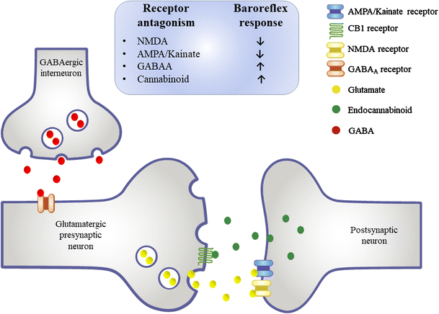
LTP-like Central Sensitization
Requires NMDA receptor-mediated Ca2+ influx into spinal neurons.
May also involve GABAergic or Glycine receptors
  Reduced activity at these receptors = loss of inhibition = facilitation
Ferreira-Junior et al., 2018

Slide 10
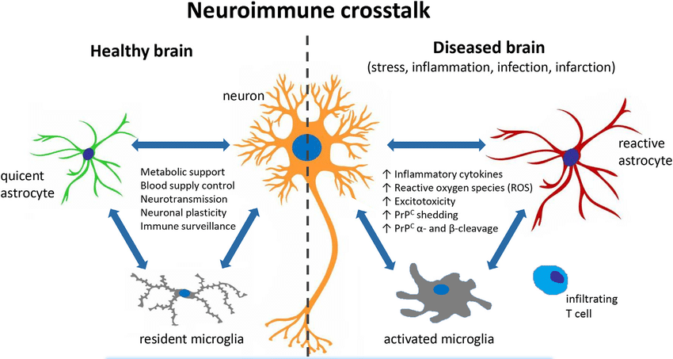
Glial cells involved in Central Sensitization
Astrocytes:
  produce chemokines that enhance neuronal excitability
Microglia:
  release cytokines (e.g., IL-1β, TNF) that promote COX-2 transcription (AA → PGE2) that enhance neuron excitability
  Produce TNF-α and BDNF, which enhance excitatory synaptic transmission and suppress inhibitory synaptic transmission
Salvesen et al., 2019

Slide 11
Main Takeaways
Perception of pain is complex! And therefore, so too is pain relief
Nociceptive information can be sent to the brain, but the brain can exert top-down control and alter such pathways.
Mechanical stimulation at the site of an injury can potentially “gate” pain signals.
Tissue damage releases many different chemicals that lead to inflammation.
Peripheral sensitization makes slightly painful stimuli seem more painful because of inflammation and increased firing rate of nociceptors.
Central sensitization makes a non-noxious stimulus seem painful due to increased excitability of neurons in the dorsal horn.

